Slide 1
Advanced Methods for Text classification
Instructor: Assoc.Prof. Le Anh Cuong
Ngo Minh Tuan – 51503629

Slide 2
OUtline
01
Theorical issues:
Multi-class problem in text classification
02
Machine learning method:
Support Vector Machines (SVM)
03
Machine learning method:
Logistic Regression
04
Demo:
Spam classification with SVM & Logistic regression
1

Slide 3
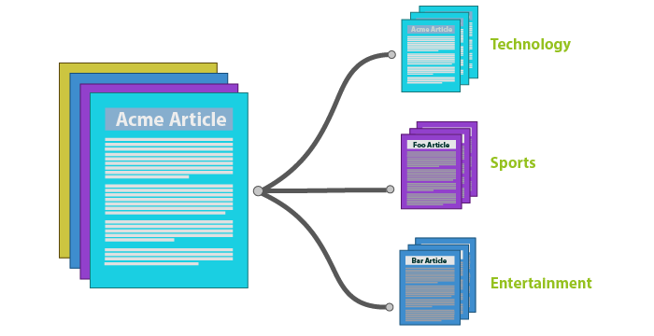

What is Text classification?
Text classification also known as text tagging or text categorization is the process of categorizing text into specific groups.
By using Natural Language Processing, text classifiers can automatically analyze text and then assign a set of pre-defined tags or categories based on its content.
2

Slide 4

Multi-class problem in Text classification
Binary classification
Multiclass classification is used to predict:
One of three or more possible outcomes.
And the likelihood of each one.
3

Slide 5
OUtline
01
Theorical issues:
Multi-class problem in text classification
02
Machine learning method:
Support Vector Machines (SVM)
03
Machine learning method:
Logistic Regression
04
Demo:
Spam classification with SVM & Logistic regression
4

Slide 6
Support Vector Machines (SVM)
It’s an algorithm of the group of Supervised learning in Machine learning.
It’s used to classify data into separate groups,
based on the hypothetical space of the linear function in n-dimensional characteristic space,
along with the algorithm to optimize the deviation from statistical theory.
The SVM model makes predictions from analyzing a previous dataset.
5

Slide 7
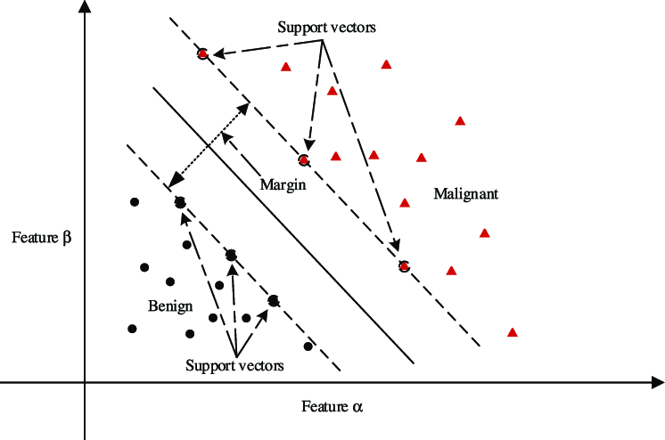
Support Vector Machines (SVM)
Support vectors are the data points nearest to the hyperplane.
Support vectors machine is a border for best layer division (-hyperplane).
Margin is a measured from hyperplane
to the nearest two data points
corresponding to the layers.
6

Slide 8
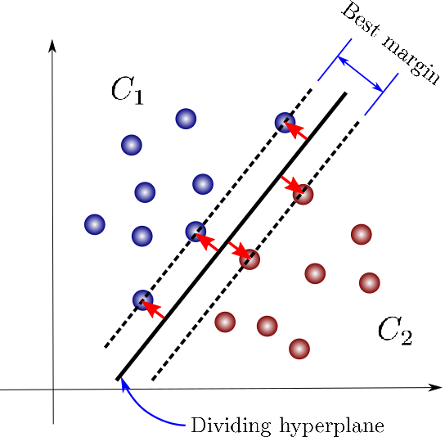
Support Vector Machines (SVM)
The goal of the SVM algorithm
is to choose a hyperplane with the maximum margin. The larger the margin, the more accurate the
classification data.
7

Slide 9
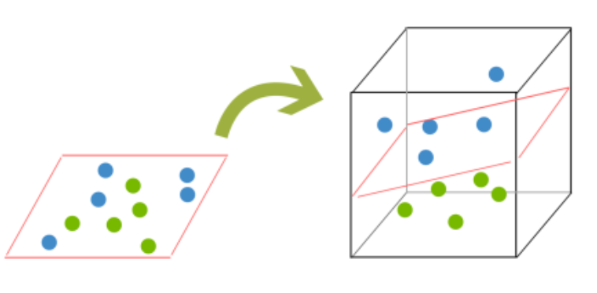
Support Vector Machines (SVM)
In case the data is not well filtered, we will not be able to find hyperplane in 2-dimensional space, , but with n dimensions.
Problem:
8

Slide 10
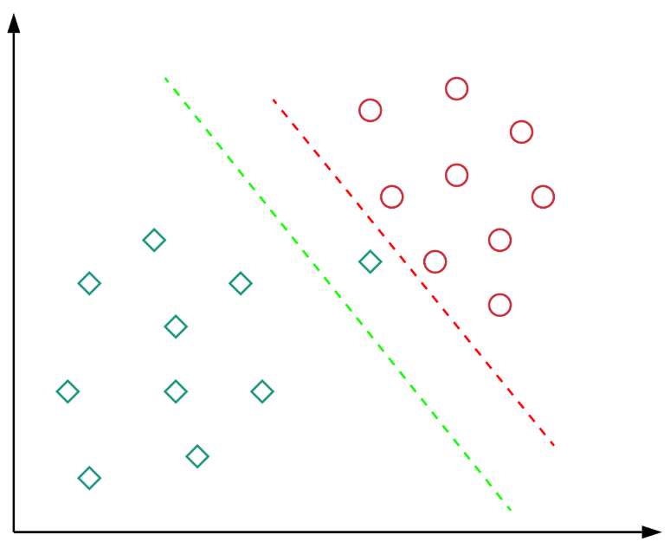
Support Vector Machines (SVM)
Problem:
In the case the data is not independent.
Here, the red decision boundary completely separates all training points.
However, the blue boundary has a wider
margin for it to generalize well on other
data points.
9

Slide 11
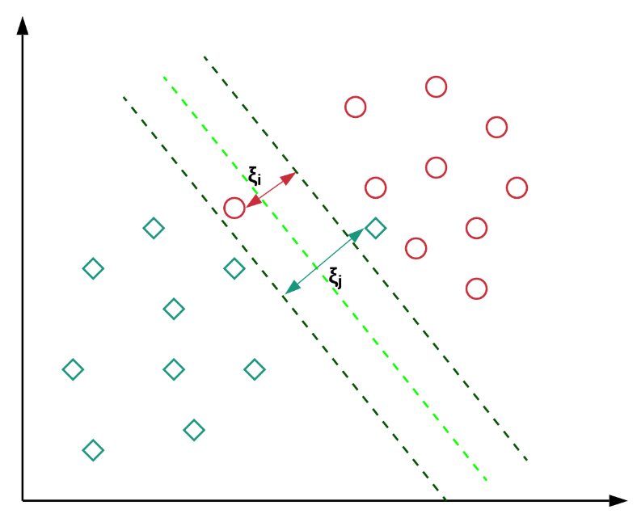

Support Vector Machines (SVM)
Solution:
Use soft margins to keep the margin as wide as possible so other points can still be classified correctly.
Soft margin:
corresponding to the points closest to the margin and on the wrong side of the margin, the support vector.
10

Slide 12
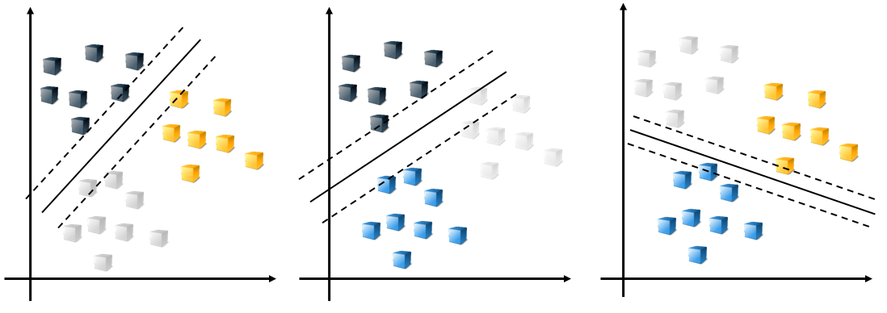
Multi-class SVM
SVM was mainly proposed to deal with binary classification.
Today’s life, we mostly have huge amount of data which we want to classify. In this there will be more than two classes.
Multiclass classifications through binary include One-vs-one and One-vs-all, Directed acyclic graph SVM, Error correcting output codes.
11

Slide 13
OUtline
01
Theorical issues:
Multi-class problem in text classification
02
Machine learning method:
Support Vector Machines (SVM)
03
Machine learning method:
Logistic Regression
04
Demo:
Spam classification with SVM & Logistic regression
12

Slide 14
Logistic Regression
It’s an algorithm of the group of Supervised learning in Machine learning.
It’s used for classification issues.
Logistic regression is a prediction analysis algorithm, based on the analysis of a previous data set, combined with the foundation of probability.
13

Slide 15

Logistic Regression
One can call the logistic regression model a linear regression model, but the logistic regression using the cost function is more complicated than the linear regression model.
Linear regression:$h_{θ}(x)=w_{a}∗x+w_{b}$
Logistic regression: $h_{θ}\left(x\right)=σ\left(z\right)=\frac{1}{1+e^{−z}} ,$
$$h\left(θ\right)∈\left[0,1\right], z= w_{a}∗x+w_{b}$$
14

Slide 16
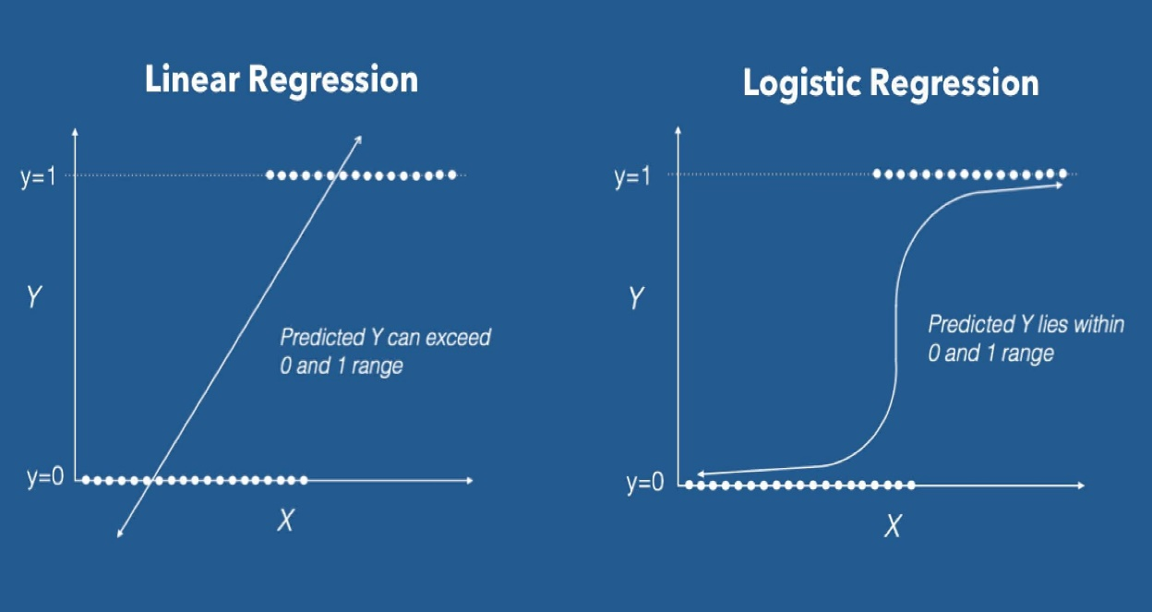


Logistic Regression
Cost function of linear regression model:
$$J\left(θ\right)=\frac{1}{2}∗\sum_{i}^{m}{{(h_{θ}\left(x^{i}\right) − y^{i})}^{2}}$$
Cost function of logistic regression model:
$$J\left(θ\right)= −\frac{1}{m}∗ \sum{[ y^{i}∗log(h_{θ}\left(x^{i}\right))+\left(1− y^{i}\right)∗\log\left(1− h_{θ}\left(x^{i}\right)\right) ] }$$
15

Slide 17
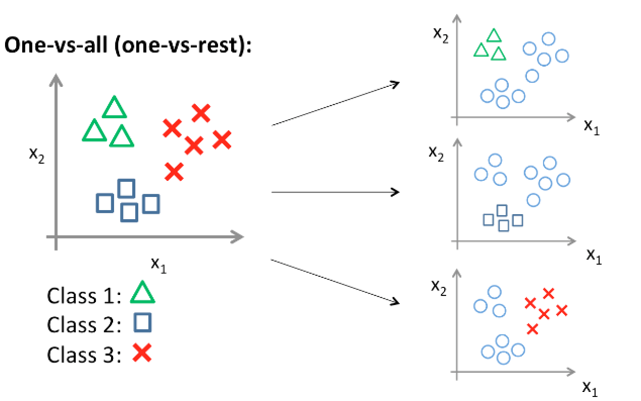
Multi class Logistic Regression
Logistic regression was mainly proposed to deal with binary classification.
Multiclass classification with logistic regression can be done either through the one-vs-rest scheme.
16

Slide 18
OUtline
01
Theorical issues:
Multi-class problem in text classification
02
Machine learning method:
Support Vector Machines (SVM)
03
Machine learning method:
Logistic Regression
04
Demo:
Spam classification with SVM & Logistic regression
17

Slide 19
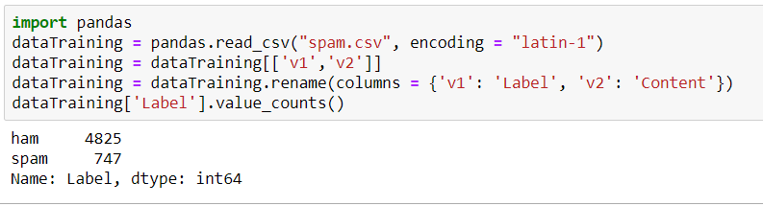
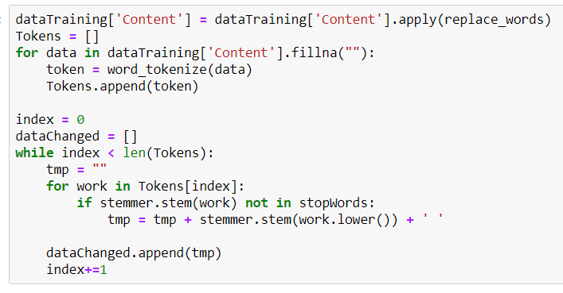
Demo
18

Slide 20
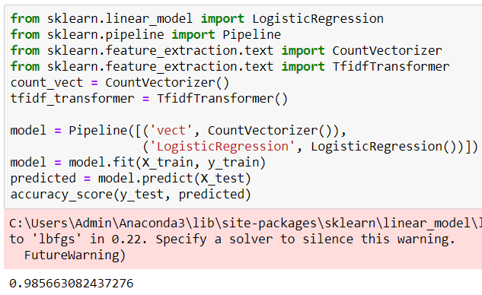
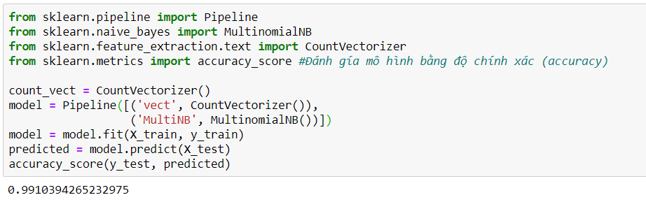
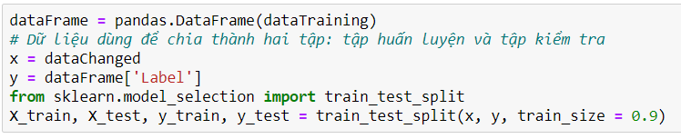
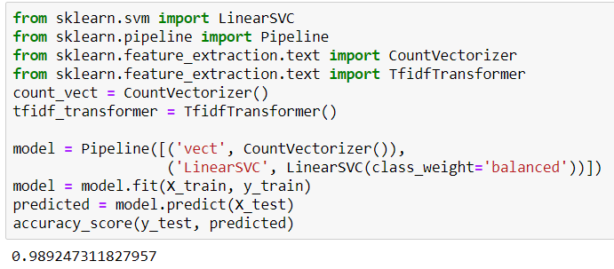
Demo
19

Slide 21
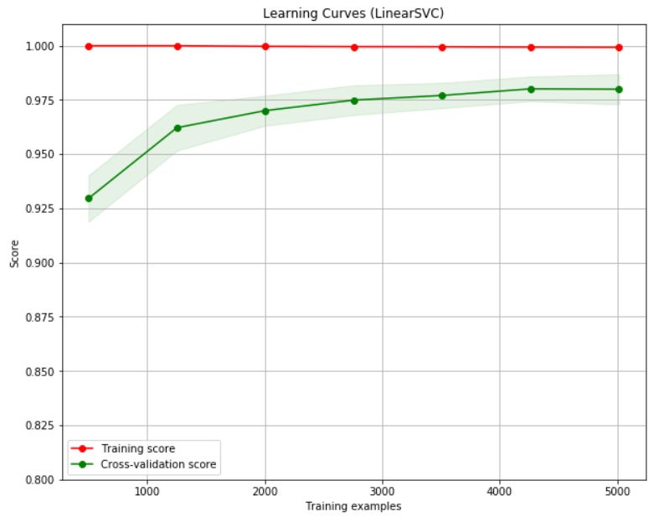
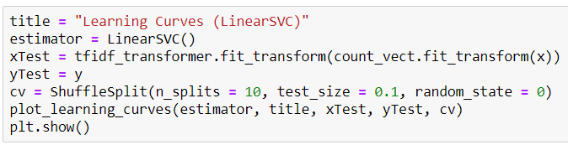
Demo
20

